Slide 1
PURSUING THE GROUP TRAVEL MARKET

Slide 2
We are a non-profit destination marketing organization dedicated to promoting our members and showcasing the best of our state to the group travel motorcoach market, both domestically and internationally.

Slide 3
OFFICE OF GROUP TRAVEL
Newly established Office of Group Travel within Travel Wisconsin. Led by Sara Brish with strong support from David Spiegelberg. This dedicated bureau has been created to support the Meetings, Sports, International, and Group Travel markets.

Slide 4
ADVANTAGES OF GROUP TRAVEL
Ecomonical
Convenient - Worry Free
Companionship
Educational
Safety
Green
and most importantly FUN!

Slide 5
TOUR OPERATOR VS GROUP LEADER
TOUR OPERATORS
GROUP LEADER
A Tour Operator may or may not have a fleet of motorcoaches. Offers full planning services and a variety of itineraries
Retail on website
Customized tours for group leaders
A group leader can be you, your neighbor, or anyone who has decided to get 10 or more people together for a day event or an extended tours
May do all the leg work or could work with a tour operator.

Slide 6
PLANNING PROCESS
IDEA
RESEARCH
CREATE & BOOK
MARKET/PROMOTE
SELL

Slide 7
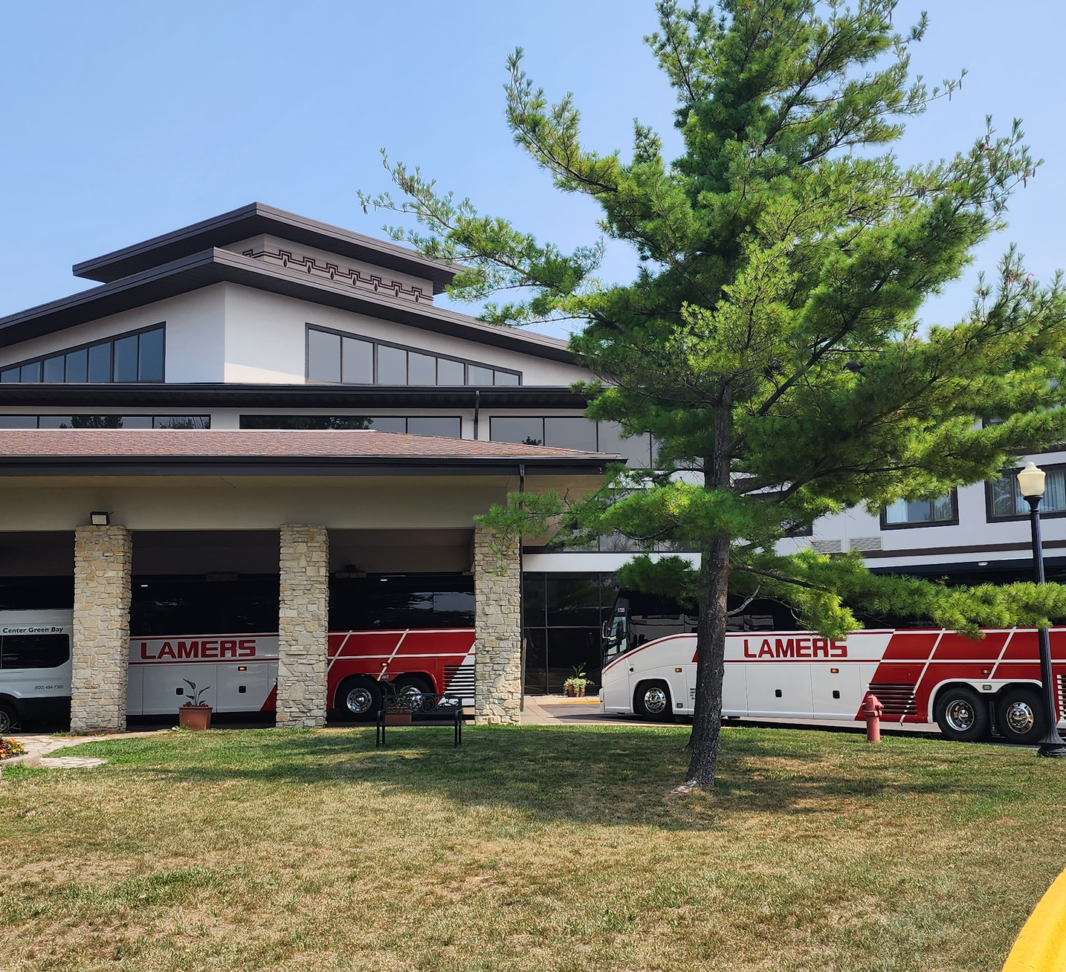
WEBSITE
Group Tour Tab
Escort Notes
Color Photos
w/ motorcoach
groups
Testimonials
Maps & Directions
Motorcoach Parking
Contact Information

Slide 8
BEING GROUP FRIENDLY
Complimentary admission, meal, room for tour escort & driver
FREE motorcoach parking
Experiences
Added value
Flexibility

Slide 9
CW WEBSITE LISTING
PREMIER MEMBERS: 75 words and up to 10 images (jpeg or png)
ASSOCIATE MEMBERS: 50 words and up to 6 images (jpeg or png)
Links to your website
Links to the contact email
Can add a video (yearly fee of $150)
NEW: Add a pdf of your profile sheet or an itinerary
NEW: Add Holiday Experience/Event

Slide 10
CONTRACTS
GROUP RATE/PRICE PER ROOM
PARKING FEE, IF ANY
CANCELLATION POLICY
DEPOSIT .. IF POSSIBLE REFUNDABLE OR TRANSFERABLE
COMP POLICY
NO ATTRITION
DEADLINE .. 45 TO 30 DAYS OUT
OPERATORS WILL WORK WITHIN REASONABLE TIME LIMITS. TOUR GROUPS ARE NOT ON THE SAME SCHEDULE AS SPORTS OR MEETING GROUPS.

Slide 11
INDUSTRY EVENTS
American Bus Association (ABA)
National Tour Association (NTA)
Heritage Peer
Select Travel
Going on Faith
Ontario Motorcoach Association (OMCA)
Wisconsin Park & Rec
Great Day Travel Marketplace
United Motorcoach Association
Travel Alliance Partners
US Travel IPW
International Inbound TravelAssociation (IITA)’
State Motorcoach Associations
Midwest Motorcoach
New England Motorcoach
Pennsylvania Bus Association
Tennesse Motorcoach Association

Slide 12
CIRCLE WISCONSIN MIDWEST MARKETPLACE
April 6 - 8
Dubuque, IA
Budget-friendly:
$495/member
$750/non member
Over 35 one-on-one appointments with tour operators/plan

Slide 13
SALES SHEETS
CONTACT INFORMATION
IMAGES
MAP
EXPERIENCES/SPECIAL EVENTS
DESCRIPTION
PRICING
AREA ATTRACTIONS

Slide 14
Images
Map
Contact Info
Area Attractions
Comp Policy
Extras

Slide 15
Images
Map
Regional
Distances
Contact Info
Area Attractions

Slide 16
Images
Map
Contact Info
Programs
Meal Options
Parking
Comp Policy

Slide 17
Images
Map
Contact Info
Programs
Holiday
Meal Options
Parking

Slide 18
GROUP TRAVEL PUBLICATIONS
Circle Wisconsin Annual Tour Planner
Leisure Group Travel
Group Tour Magazine
Group Travel Leader

Slide 19
FOLLOW-UP
ADD TO YOUR DATABASE
SEND INTRODUCTION LETTER/EMAIL
STAY IN TOUCH/SEND UPDATES
INVITE THEM TO EXPERIENCE YOUR ATTRACTION (FAM)
FOLLOW OPERATORS/PLANNERS ON SOCIAL MEDIA
It takes time and patience to
build relationships.

Slide 20
ECONOMIC IMPACT - $1.7 B
Each year, our state to approximately 330,000 room nights for group tours. This impressive figure is akin to accommodating the equivalent of about 70 major conventions and/or sporting events annually. Such activity not only highlights the appeal of Wisconsin as a destination but also underscores its significant contribution to our local economy.
Reference: ABA Foundation Economic Impact

Slide 21
THANK YOU

